Slide 1
Programming Fundamentals
Course Code: CS-111
Course Instructor: Isra Naz

Slide 2

CLO Covered in this Lecture:
CLO2 - Applies basic programming concepts through hands-on experience with C++ syntax and structure.

Slide 3

Goal for today:
Iteration statement
While loop
Do While loop

Slide 4
Quiz 2
In Progress

Slide 5
What are Loops?
In sequential structure, all statements are executed once.
On the other hand, conditional structure may execute or skip a statement on the basis of some given condition.
In some situations, it is required to repeat a statement or number of statements for a specified number of times.
A type of control structure that repeats a statement or set of statements is known as looping structure
It is also known as iterative or repetitive structure.
Looping structures are used for this purpose
There are different types of loops available in C++

Slide 6
Loops
Loops are basically used for two purposes:
To execute a statement or number of statements for a specified number of times.
E.g. a user may display his name on screen for 10 times
To use a sequence of values.
E.g. a user may display a set of natural numbers from 1 to 10

Slide 7
Types of loops
There are three types of loops available in C++. These are as follows
While loop
Do-While loop
For loop

Slide 8
While Loop
Simplest loop of C++ language
This loop executes one or more statements while the given condition remains true
It is useful when the number of iterations is not known in advance
Syntax
while (condition)
statement;

Slide 9
While loop
Condition
The condition is given in relational expression. The statement is executed only if the given condition is true. If the condition is false, the statement is never executed.
Statement
Statement is the instruction that is executed when the condition is true. If two or more statements are used these are given in braces { }.
It is called body of loop.

Slide 10
While Loop
The syntax for compound statements is as follows
While(condition)
{
statement 1;
statement 2;
.
.
.
statement N;
}

Slide 11
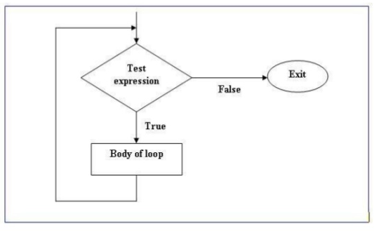
Flow chart for while loop

Slide 12
Example(While loop)
int main()
{
int a = 1;
while(a<=5)
{
cout<<“Value of a = ”<< a <<endl;
a++;
}
Return 0;;
}
Output:
Value of a = 1
Value of a = 2
Value of a = 3
Value of a = 4
Value of a = 5

Slide 13
Example 1
Write a program that displays counting from 1 to 10 using while loop

Slide 14
Example 1
Write a program that displays counting from 1 to 10 using while loop
int main()
{
int n =1;
while (n<=10)
{
cout<<n<<endl;
n++;
}
}
Output
1
2
3
4
5
6
7
8
9
10

Slide 15
Example 2
Write a program that displays first five numbers and their sum using while loop.
Output
1
2
3
4
5
Sum is = 15

Slide 16
Example 2
Write a program that displays first five numbers and their sum using while loop.
Int main()
{
int c, sum;
c=1;
sum=0;
while(c<=5)
{
cout<<c<<endl;
sum = sum + c;
c=c+1;
}
Cout<<“Sum is = ”<<sum;
}
Output
1
2
3
4
5
Sum is = 15

Slide 17
Example 3
Write a program that displays first five numbers with their squares using while loop
Output
1 1
2 4
3 9
4 16
5 25

Slide 18
Example 3
Write a program that displays first five numbers with their squares using while loop
Int main()
{
int n;
n = 1;
while (n<=5)
{
cout<<n<<“\t”<<n*n<<endl;
n++;
}
}
Output
1 1
2 4
3 9
4 16
5 25

Slide 19
Example 4
Write a program that inputs a number from the user and displays a table of that number using while loop.

Slide 20
Example 4
Write a program that inputs a number from the user and displays a table of that number using while loop.
Int main()
{
int n,c;
c = 1;
cout<<“Enter a number:”;
cin>>n;
while(c<=10)
{
cout<<n<<“*”<<c<<“=“<<n*c<<endl;
c=c+1;
}
}

Slide 21
Guess the Output:
int x = 10;
while (x != 5) {
cout << "X = " << x << endl;
x--;
}
Notes:
// What if we change this to x++?

Slide 22
Guess the Output: How many times will this loop print? Predict the output sequence.
int count = 1;
while (count < 50) {
cout << "Count is " << count << endl;
count *= 2;
}
Notes:
// What if we change this to x++?

Slide 23
Guess the Output:
int y = 1;
while (y != 0) {
cout << y << endl;
y = y / 2;
}
Notes:
Will this loop end? If yes, what would be the last output? If no, explain why.

Slide 24
Example 5
Write a program that inputs a number from the user and displays the factorial of that number

Slide 25
Example 5
Write a program that inputs a number from the user and displays the factorial of that number
int main()
{
int n, factorial = 1, c = 1;
cout << "Enter a number: ";
cin >> n;
while (c <= n) {
factorial *= c;
c++;
}
cout << "Factorial of " << n << " is " << factorial;
}

Slide 26
Example 6
Write a program that inputs a positive number. It then displays the sum of all odd numbers and the sum of all even numbers from 1 to the number entered by the user
Output
Enter a positive number 5
The sum of even digit is = 6
The sum of odd digit is = 9

Slide 27
Example
{
int n, oddsum = 0, evensum = 0;
cout<<“Enter a positive number “;
cin>>n;
while (n>=0)
{
if(n%2 = = 0)
evensum = evensum + n;
else
oddsum = oddsum + n;
n--;
}
cout<<“The sum of even digit is = “<<evensum<<endl;
cout<<“The sum of odd digit is = “<<oddsum;
}
Output
Enter a positive number 5
The sum of even digit is = 6
The sum of odd digit is = 9

Slide 28

It is similar to while loop but the difference is that the loop condition is tested after execution of the statement(s) in the body of loop.
Therefore, the body of the loop is executed at least once before the condition is tested.
If the loop condition evaluates to false at any stage of program execution, the loop terminates and control shifts to the next statement following the do-while block.
It is an important loop in a situation when the loop body must be executed once.

Slide 29
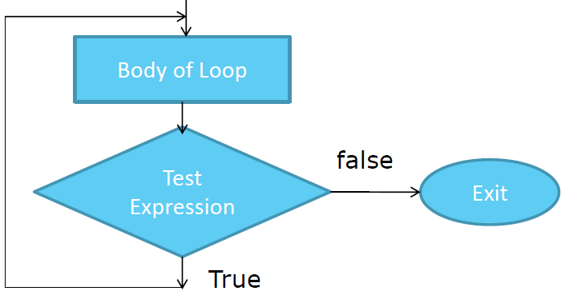

Slide 30
do
{
statements;
}
Note the semi-colon
while (condition);

Slide 31
#include<iostream> int main()
{
int i=0;
do
{
cout<<i<<endl; i++;
}
while(i<10);
return 0;
}

Slide 32
Difference b/w while & do-while
While Loop | Do-While loop
In while loop, condition comes before the body of the loop | In do while loop condition comes after the body of the loop
If condition is false in the beginning while loop is never executed | Do while is executed at least once even if condition is false in the beginning

Slide 33
Example (do-while loop)
void main()
{
int a = 1;
do
{
cout<<“Value of a = ”<< a <<endl;
a++;
}
while(a<=5);
getch();
}
Output:
Value of a = 1
Value of a = 2
Value of a = 3
Value of a = 4
Value of a = 5

Slide 34
Try it your self
Write a program that gets starting and ending point from the user and displays all odd numbers in the given range using do-while loop and your output must be look like the following
Output
Enter starting number: 5
Enter ending number: 15
5
7
9
11
13
15

Slide 35
Try it your self
Write a program that gets two numbers from the user and displays the result of first number raise to the power of second number using do-while loop.
Output
Enter first number 2
Enter second number 3
Result is 8

